Slide 1

DEPARTURES FROM: Aviano, AB, Italy (AVB) Friday, June 27th, 2025
Optional
Unit
Crest
ROLL CALL | DESTINATION | SEATS
N/A | NO SCHEDULED FLIGHTS | N/A
Seats: T - Tentative, F - Firm, TBD - To Be Determined
ALL FLIGHTS SCHEDULES ARE SUBJECT TO CHANGE WITHOUT NOTICE

Slide 2
DEPARTURES FROM: Aviano, AB, Italy (AVB) Saturday, June 28th, 2025
Optional
Unit
Crest
ROLL CALL | DESTINATION | SEATS
N/A | NO SCHEDULED FLIGHTS | N/A
Seats: T - Tentative, F - Firm, TBD - To Be Determined
ALL FLIGHTS SCHEDULES ARE SUBJECT TO CHANGE WITHOUT NOTICE

Slide 3
Passenger Assistance
Optional
Unit
Crest
Please visit the Passenger Service Center for questions/concerns &
contact us prior to travel for the latest updates/information on flight restrictions
& flight information.
Commercial: +39-0434-308242
DSN: (314) 632-8242
Email: AvianoSpaceA@us.af.mil
Hours of operation:
0800L-1500L
AMC Passenger Terminal Survey or Interactive Comment Evaluations (ICE)
QR Code is also available through out the Terminal Area
https://ice.disa.mil/index.cfm?fa=card&sp=112382&s=404&dep=*DoD&sc=30

Slide 4
Space Available Reminders
Optional
Unit
Crest
• SPACE AVAILABLE (SPACE-A) IS A PRIVILEGE
• WHEN MISSION & CARGO LOADS ALLOW, SEATS MAY BE MADE AVAILABLE TO
ELIGIBLE PASSENGERS
• PLEASE BE AWARE THAT SPACE-A TRAVELERS MUST BE PREPARED TO COVER
COMMERCIAL TRAVEL EXPENSES IF SPACE-A FLIGHTS ARE CHANGED OR BECOME
UNAVAILABLE
• PER DODI 4515.13, SECTION 4 PARAGRAPH 4.1.A, RESERVATIONS: THERE IS NO
GUARANTEE OF TRANSPORTATION, AND RESERVATIONS WILL NOT BE ACCEPTED OR
MADE FOR ANY SPACE AVAILABLE TRAVELER. ALL FLIGHTS ARE SUBJECT TO CHANGE
OR CANCELLATION WITHOUT NOTICE
ACTIVE DUTY PERSONNEL: TO SIGN UP FOR THE SPACE A PROGRAM YOU MUST BE
IN LEAVE STATUS

Slide 5
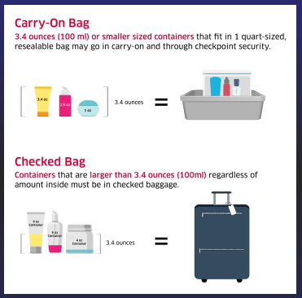
Space Available Reminders
Optional
Unit
Crest
• WE FOLLOW TSA GUIDELINES: https://www.tsa.gov/
Each passenger may check two pieces of luggage up to 70 pounds and 62 linear (length+width+height) inches each. Motorized assistance equipment may not exceed 100 pounds in weight.
Luggage allowances may be combined per family, e.g. 4 checked items are allowed for a 2-passenger family (Pooling baggage). Passengers should include their name and current address on or inside checked luggage. It is also advisable to place a copy of appropriate leave paperwork in checked luggage.
Passengers are also permitted one, 45-linear inch, hand-carried item, e.g. small suitcase, garment bag, backpack. This item must fit under the seat or in available overhead compartments in the cabin area. Items that are too large must be checked and will count against the passenger's checked luggage limit and One hand-carried, personal item, e.g. cosmetic case, purse, briefcase, is also permitted. Note: Luggage allowances may be limited by smaller-size aircraft or other factors. Check with passenger service agents for more information.
Per AMC: Excess Baggage costs are $125 per excess baggage piece

